Slide 1

Multiple Linear Regression by
Dr Lalit Prasad

Slide 2
Outline
What is Multiple Linear Regression ?
Assumptions
An example : Multiple Linear Regression

Slide 3
Multiple Regression
If we find the impact of two or more independent variables on a dependent variable, is known as multiple regression.

Slide 4
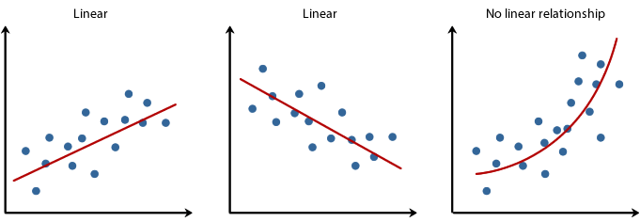
Assumptions of Multiple Linear Regression
Scale of measurement: Data should be in interval or ratio scale for all independent variables and dependent variable.
Linearity: There must be linear relationship between variables.

Slide 5
CONTINUED….
Assumption of normality of residuals: Multiple regression assumes that the residuals are normally distributed.
Assumption of Multicollinearity: Independent variables should not be highly correlated with each other. This assumption is tested using Variance Inflation Factor (VIF) values(should not be more than 10 ).

Slide 6
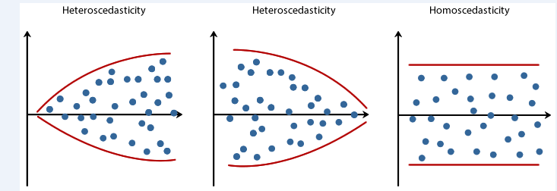
Homoscedasticity: The variability in scores for one variable is approximately the same at all levels at other variable i.e. it is concerned with how the scores cluster uniformly around regression line.

Slide 7

Linear Regression Equation
Simple Linear Regression
y= a+ bx± є
є
Dependent variable (y)
b = slope
= ∆y/ ∆x
a (y intercept)
Independent variable (x)
The output of a regression is a function that predicts the dependent variable based upon values of the independent variables.
Simple regression fits a straight line to the data.

Slide 8
Simple Linear Regression
Prediction error: ε
Observation: y
^
Prediction: y
Zero
For each observation, the variation can be described as:
y = y + ε
Actual = Explained + Error
^

Slide 9
Terminologies in Regression Analysis
y intercept or constant : Even if the value of x is 0, then also the y will have some value which is the constant (b₀).
b₁, b₂, b₃…..= beta or slope: If x_{i} value increases by 1 point , then y will increase by b_{i}.
R square : x_{i} (independent variables) explains….% of the y (dependent variable)

Slide 10
Significant Value: p –value if p<0.05 at 5% level of significance. H₀ is rejected.
Residual : difference between actual (Observed) value and explained (predicted) value.
= Observed Value- Predicted Value
Standard Error : Variance of residuals.

Slide 11
Degree of Freedom : the minimum number of observations required to estimate the regression.
= n-k-1, where, n= number of observations, k= number of explanatory variables (x_{i})
Adjusted R² : Low df = Low adjusted R²
As ‘k’ increases, adjusted R² decreases, reflecting the reduced power in the model.
This happens when we add unnecessary variables into the model.
But if we add useful variables into the model, adjusted R² will also increase along with R². Which proves to be a good model.

Slide 12
Multiple Linear Regression Equation or Model
y= Dependent Variable
x_{i} = Independent Variables, i=1,2,3…..
b₀ = y-intercept (Constant)
b_{i} = Slope, i= 1,2 ,3……
y = b₀ +b₁x₁+b₂x₂+b₃x₃+……+ ε_{i}

Slide 13
Topic
A study of consumer buying behavior parameters (Awareness, Perception, Attitude, cost and Rating) on purchase intension of Green Buildings: An empirical Study in Pune

Slide 14
Variables and Scale of Measurement
Scale of Measurement for both independent and dependent variables: 7 point likert scale
Independent variables:
Awareness
Perception
Attitude
Cost
Ratings
b) Dependent variable:
1. Purchase Intension

Slide 15
Objectives
To study the consumer buying behavior parameters (awareness, perception, attitude, cost and rating) and purchase intention of the respondents.
To study the impact of consumer buying behavior parameters (awareness, perception, attitude, cost and rating) on purchase intension of the respondents.

Slide 16
Hypotheses
Null Hypothesis: H₀: There is no significant impact of consumer buying behavior parameters (awareness, perception, attitude, cost and rating) on purchase intension.
Alternative Hypothesis: H₁: There is a significant impact of consumer buying behavior parameters (awareness, perception, attitude, cost and rating) on purchase intension.

Slide 17
Data and Data Analysis

Slide 18
Reporting of Result(Output)
The data collected for analysis holds all the assumptions of multiple linear regression.
The significant value in ANOVA table is 0.000<0.05, So it has sufficient evidence as per decision rule to reject the null hypothesis. Hence, H₁ i.e. Alternative Hypothesis is accepted.
It means that there is a significant impact of consumer buying behavior parameters on purchase intension .
But in coefficient table , the significant value of the consumer buying behavior parameters : awareness, attitude, perception and cost are less than 0.05, which is significant, but the significant value of rating is greater than 0.05. It means, rating has no impact on purchase intention.

Slide 19
Also the adjusted R² value is 0.803, it means, the dependent variable i.e. purchase intension is explained 80.3% by the independent variables (awareness, attitude perception and cost)
One independent variable ( rating) is not included as the significant value of rating is greater than 0.05.
The multiple regression equation y (Purchase intension ) on x_{i} (Awareness(x₁), attitude(x₂), perception(x₃), cost (x₄)) is:
y =0.442+0.388(x₁) +0.359(x₂)+0.252(x₃)+0.090(x₄)

Slide 20
Thank You

